Slide 1
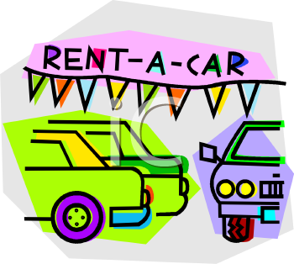


OntarioTechU - Car4U
Mobile Application Development Final Project Proposal
Danny Lionel

Slide 2

Introduction
OntarioTechU - Car4U
Running low on cash?
OSAP didn’t cover tuition fees?
Make income on the side without “working”?
Do you have your own car?

Slide 3
Objective
Provide the simplest way for students to rent out their car or book cheap rental cars right on their smartphone devices.

Slide 4
Outcome
Provide easier, cheaper transportation alternatives to university student.
Don’t be late for classes ever again.

Slide 5
App
Structure
Welcome screen
No account?
Account login
Register page
After registration
Rent? Search? Profile?
Rent your car
Search for cars to rent
Specify search criteria
Display available Cars
Fill your car information
Set personal preference, view booking & listing
Booking Confirmation
View your vehicle listing
View your car bookings

Slide 6
Technical Specifications

Slide 7

MAIN SCREENS
LOGIN PAGE
REGISTER PAGE
SELECTION PAGE
YOUR CAR INFO PAGE
VIEW CAR INFO PAGE
SEARCH CAR PAGE
VIEW QUERY PAGE
CONFIRMATION PAGE
PROFILE PAGE
YOUR BOOKINGS PAGE

Slide 8





b) High-level design
Cloud Database
CAR LISTING TABLE → ID, MAKE_ID, MODEL_ID, YEAR, COLOUR, CURRENT_MILAGE, CURRENTLY_AVALIABLE, PRICE
CAR MAKE TABLE → ID, NAME
CAR MODEL TABLE → ID, CAR_MAKE_ID,
BOOKINGS TABLE → ID, CAR_ID, USER_ID, START_TIME, END_TIME
USER TABLE → ID, FIRST_NAME, LAST_NAME, USERNAME, PASSWORD, EMAIL

Slide 9
b) High-level design
App programed in JAVA
Connected to online sql database
Query’s done via PHP and results pulled with JSON

Slide 10
Limitation
Number of Users corresponds with the effectiveness of the app(#of cars being rented out)
Privacy concerns
Liability problems
Security - no encryption implementation

